Slide 1
Reproduction in humans
Year 8 Biology

Slide 2
Reproduction
Upon completion of this module you should be able to satisfy the following objectives:
Sexual reproduction
State the structures, and their functions, of the human reproductive system (male and female anatomy).
Explain the process of fertilisation in humans.
Compare the reproductive systems of flowers and humans.
Contrast fertilisation in animals with pollination in plants.
Research the use of reproductive technologies (IVF) and how developments in this rely on knowledge from different areas.

Slide 3
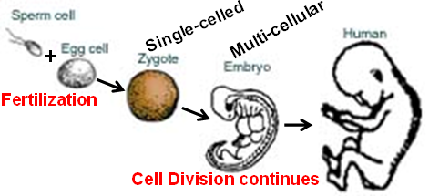
Sexual Reproduction in Animals
Involves specialised sex cells called gametes.
Male gametes = sperm, Female gametes = Ovum
The union of a sperm and an ovum results in the formation of a zygote that develops into a new individual.

Slide 4
Reproduction in humans
Read pages 67 to 71 in iScience8 – Chapter 3.
Go to the link on the following pages and work through the two ‘SKOOOL’ activities.
Complete the activity sheets
Structure and function of the female reproductive system
Structure and function of the male reproductive system
Note with the activity sheets the diagrams are the most important followed by the tables, the last question on each sheet is optional.

Slide 5
Reproduction in humans
Go to the link below and work through the two activities.
http://lgfl.skoool.co.uk/keystage3.aspx?id=63
18. The Female Reproductive System Learn the structure and function of the female reproductive organs.
19. The Male Reproductive System Learn the structure and function of the male reproductive organs.
23. Human Fertilisation Learn that fertilisation is the fusion of the egg and sperm nuclei, and know what happens to the egg after fertilisation.

Slide 6
Reproduction in humans
Go to the link below and work through the two activities.
http://kisdwebs.katyisd.org/campuses/MRHS/teacherweb/hallk/Teacher%20Documents/AP%20Biology%20Materials/Body%20Systems/Human%20Reproduction/48_A02s.swf
http://www.tutorvista.com/biology/animations/female-reproductive-system-animation
http://www.tutorvista.com/biology/animations/reproduction-system-in-male
http://kidshealth.org/parent/interactive/frs_it.html
http://kidshealth.org/parent/interactive/mrs_it.html

Slide 7
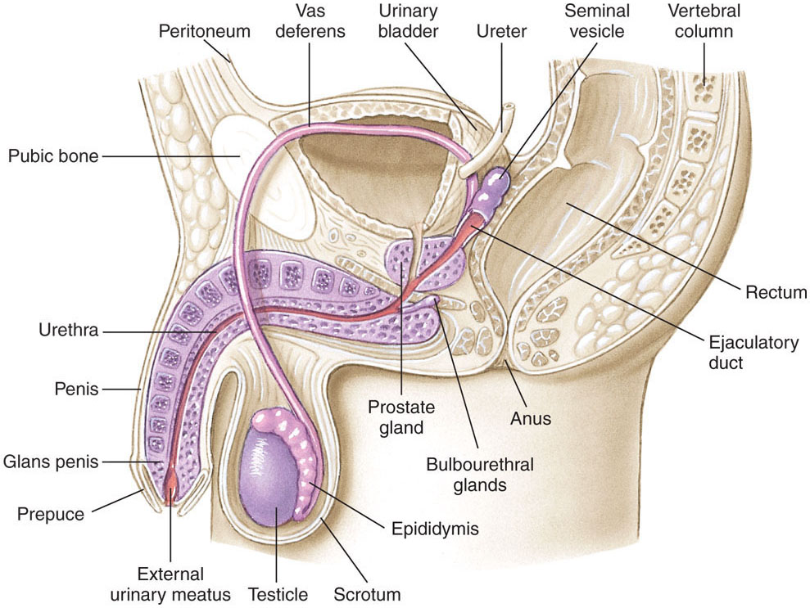

Slide 8
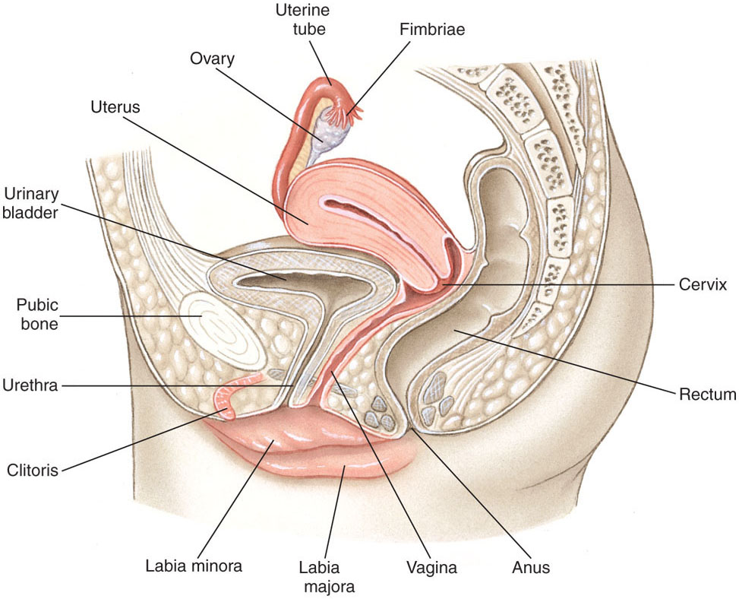
7-8

